Slide 1


User interface design Mini- Project
Topic: e-local shopping
Group members:
S. Adhwaith (CB.EN.U4CYS21063)
Siddharth Krishna (CB.EN.U4CYS21058)
D. Sanjai Prashad (CB.EN.U4CYS21066)

Slide 2


List of contents
INTRODUCTION
BENEFITS OF LOCAL SHOPPING
SUPPORTING LOCAL SHOPS
CHALLENGES FACED BY LOCAL SHOPS.

Slide 3
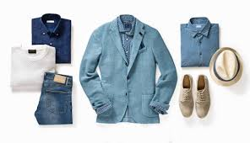
Introduction
Local shopping is the practice of acquiring goods and services from local, independently run small businesses. By keeping money in the local economy and encouraging the expansion of small companies, this kind of buying helps the community.

Slide 4
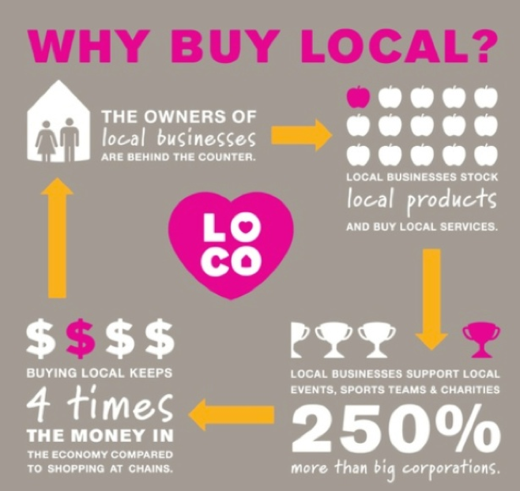
Benefits of Local Shopping
It helps in boosting the local economy.
By supporting local businesses, you can prevent money from leaving the area and going to corporate offices or out-of-town owners.
Unique and diversity of products.
By supporting neighborhood companies, you are also helping the local entrepreneurs and artists who contribute their unique ideas and creativity to the market.
Creates a healthy and strong community between local owners.

Slide 5

Support local shops
We can find no .of. Local shops in our town and through online like Instagram, Facebook ,Twitter , family and friends suggestions or in any events we can find lots of shopping related pages/ accounts.
The best way to support them is frequent purchasing of products from them.
Spreading the positive experience with our family, friends, neighbors.
Utilizing social media platforms to promote local business and products.

Slide 6
Challenges Faced by Local Shops
Large scale markets will be a threat for these local shop owners due to their wide range of collections, lower process due to higher purchasing rate, etc.
Fund problem occurs frequently for setting an eye-catchy shop, importing goods, etc.
These local shops are hard to find in locality.
local owners must offer a unique shopping experience and high-quality products.
Local businesses can also differentiate themselves by offering personalized service and a more intimate shopping experience.
To overcome this, they can form [partnerships and collaborations among various local owners.
Providing delivery services, online shopping options can help these local shop owners to establish their identity in the surroundings.

Slide 7
Conclusion
Shopping at local businesses helps to strengthen the local economy.
Local businesses are more likely to source their products and services locally, which supports other local businesses and creates a self-sustaining cycle of economic growth.
Continued support from local consumers is essential for the survival of these businesses.
Without encouragement, many local businesses could be compelled to close, which would cause the local economy to weaken and the sense of community to disappear.

Slide 8


